Slide 1
3D Face Recognition
Ravitha N

Slide 2
Agenda
Why 3D recognition?
Invariant to pose and illumination variations
Facilitate detection in unconstrained manner
Acquisition
Preprocessing
Recognition
What is 3D image
Captures the depth information about the
Surface of the object
How 3D images are stored?
Vector format
Different file formats used?
PLY, WRL

Slide 3
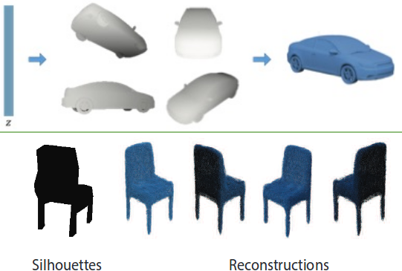
Acquisition
Passive - 3D reconstruction from 2D face images
Shape from X (X refers to 2D characteristics such as shading, texture)
Accuracy is less (not dense)
Model based approaches
More Computational Time
Active – Uses ranging scanners
(Structured Pattern Projection)
Proper Illumination is required

Slide 4
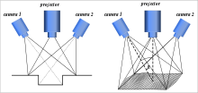
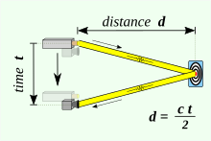
Interference between projection source and
ambient light is minimized
Active Approaches
Structured Light
Time of Flight
Distorted 2D Images enable Geometrical Reconstruction

Slide 5

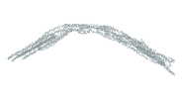















Preprocessing and normalization
Output of the sensor is noisy (exhibit holes)
Normalization involves repositioning of the face in a particular pose
[Tech 1] Sensor Noise Processing
Median filter is used
Order the points of neighbourhood based
On depth
Replace it with median value if it is an
outlier

Slide 6
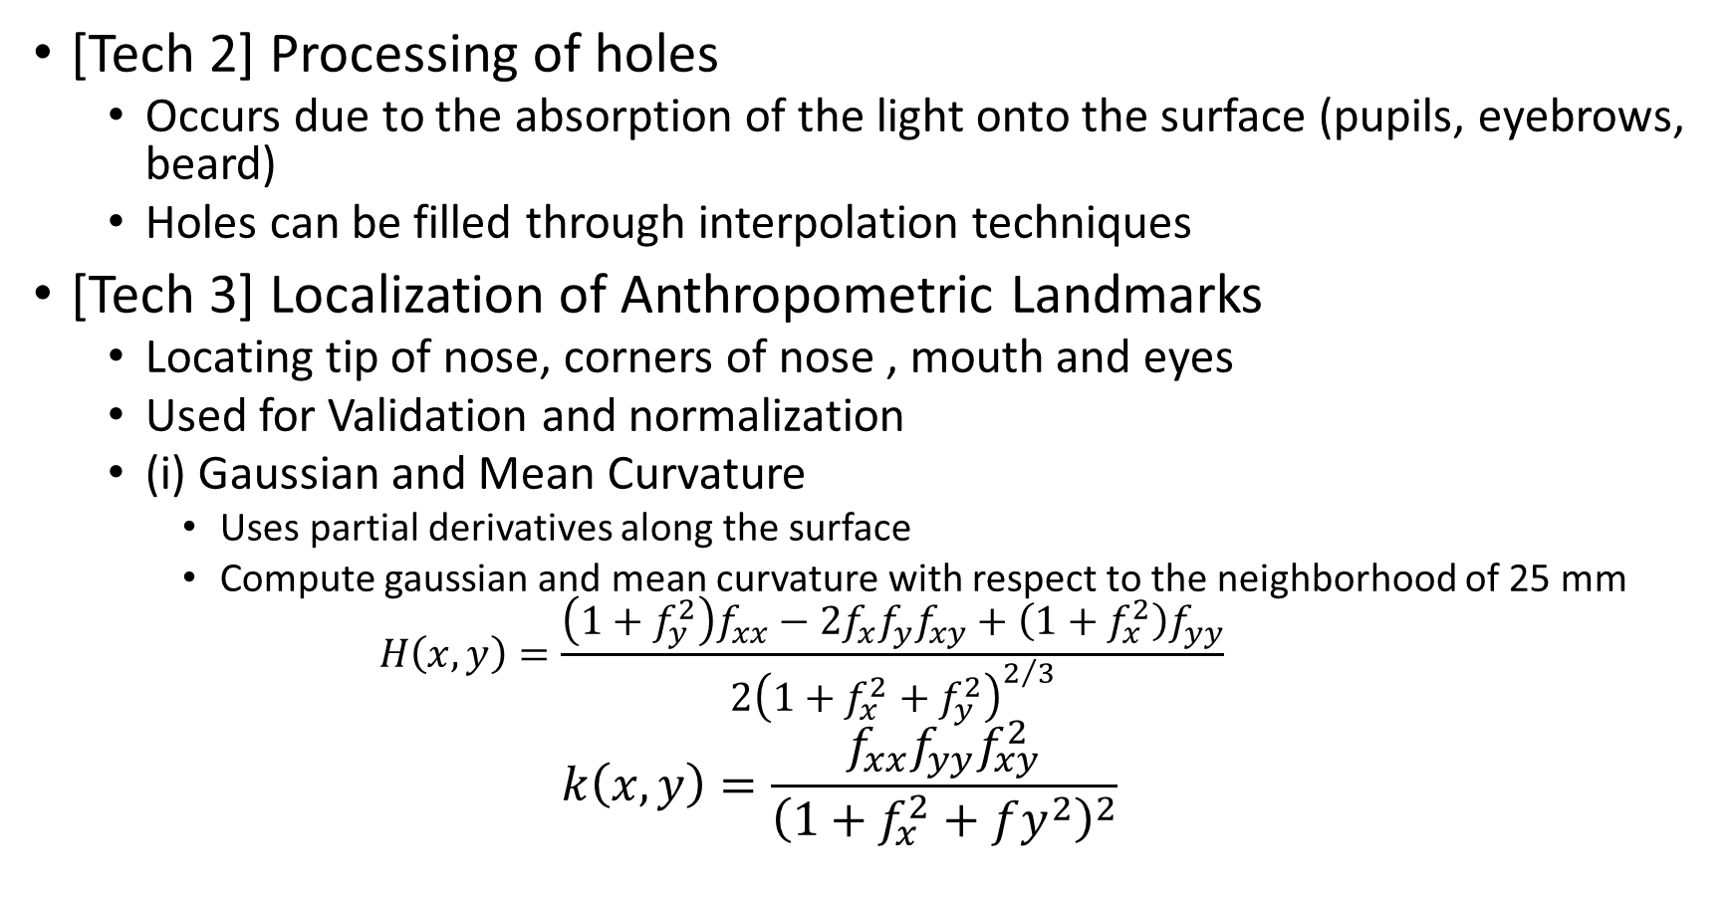
[Tech 2] Processing of holes
Occurs due to the absorption of the light onto the surface (pupils, eyebrows, beard)
Holes can be filled through interpolation techniques
[Tech 3] Localization of Anthropometric Landmarks
Locating tip of nose, corners of nose , mouth and eyes
Used for Validation and normalization
(i) Gaussian and Mean Curvature
Uses partial derivatives along the surface
Compute gaussian and mean curvature with respect to the neighborhood of 25 mm
$$H\left(x,y\right)=\frac{\left(1+f_{y}^{2}\right)f_{xx}−2f_{x}f_{y}f_{xy}+\left(1+f_{x}^{2}\right)f_{yy}}{2{\left(1+f_{x}^{2}+f_{y}^{2}\right)}^{2/3}}$$
$$k\left(x,y\right)=\frac{f_{xx}f_{yy}f_{xy}^{2}}{{\left(1+f_{x}^{2}+fy^{2}\right)}^{2}}$$

Slide 7
 | K<0 | K=0 | K>0
H<0 | Hyperbola | Convex Cylinder | Convex Ellipse
H=0 | Hyperbola | Plane
H>0 | Hyperbola | Concave Cylinder | Concave Ellipse
Use the table , to classify region
To locate nose , concave region to be identified
To locate eyes, convex region to be identified
From the set of points identified, the representative point is selected based on the maximum gaussian curvature

Slide 8
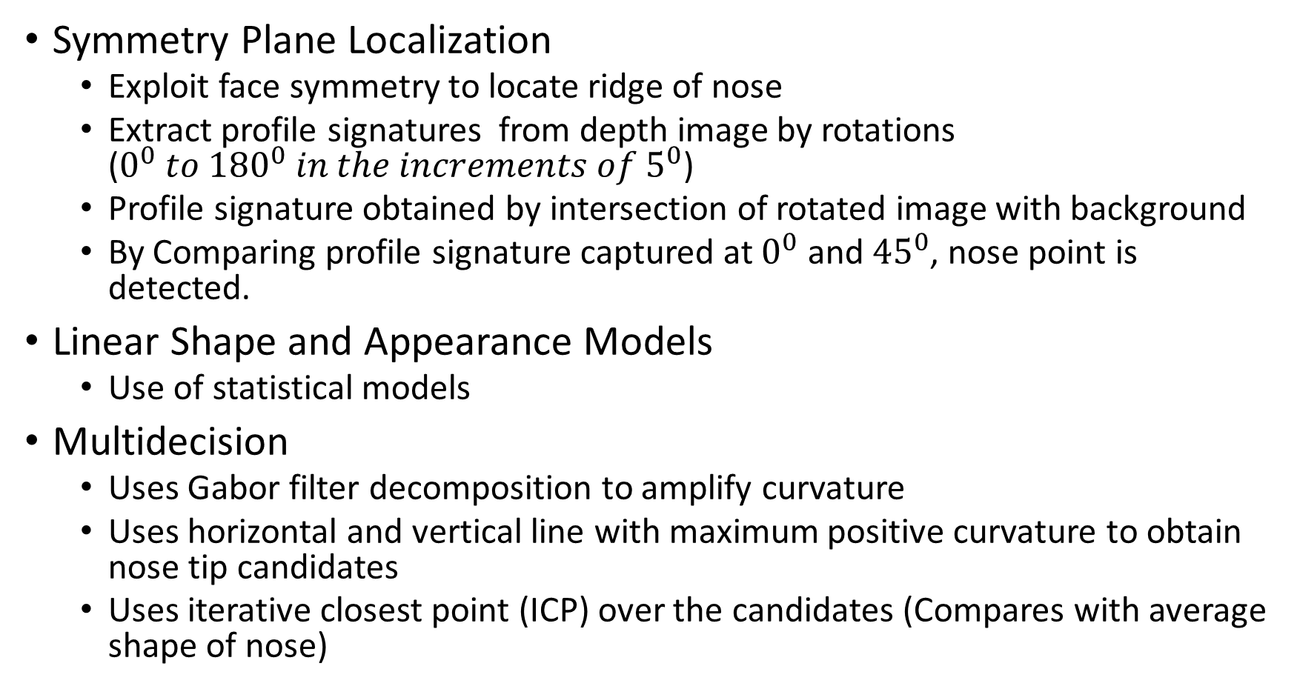
Symmetry Plane Localization
Exploit face symmetry to locate ridge of nose
Extract profile signatures from depth image by rotations ($0^{0} to {180}^{0} in the increments of 5^{0}$)
Profile signature obtained by intersection of rotated image with background
By Comparing profile signature captured at $0^{0}$ and ${45}^{0}$, nose point is detected.
Linear Shape and Appearance Models
Use of statistical models
Multidecision
Uses Gabor filter decomposition to amplify curvature
Uses horizontal and vertical line with maximum positive curvature to obtain nose tip candidates
Uses iterative closest point (ICP) over the candidates (Compares with average shape of nose)

Slide 9
Face Recognition
Global
Sensitive to Facial Expression
Require accurate normalization step
Local
Proper detection of key points
Ex: Point Signature
Robust to facial expression
Hybrid
Effective compared to both Global and Local
Ex: Multiple region based matching

Slide 10
Face Recognition using local Features
Multi scale LBP depth map
Depth map at varying depths (scales) are compared
LBP is used for feature representation
It encodes the difference between the target pixel and its neighbors as one byte information
Here, extended LBP is used for high level discrimnation

Slide 11
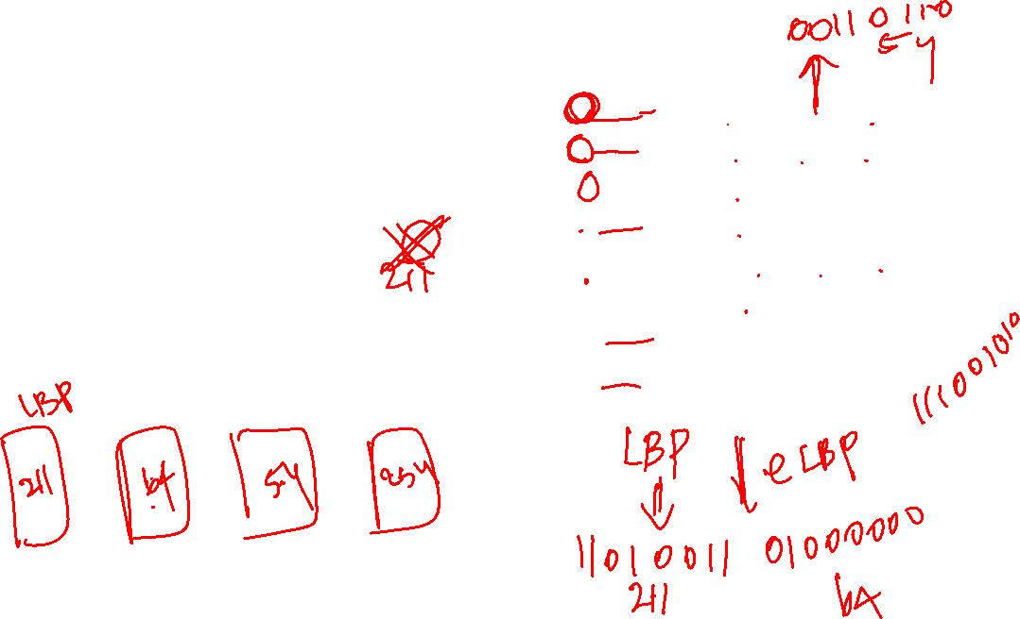
1
5
-3
2
-1
-2
3
0
1
1
0
1
0
0
1
1
0
1
0
0
0
0
0
0
0
0
1
1
0
1
1
0
1
1
1
0
1
0
1
0
5 | 9 | 1
4 | 4 | 6
7 | 2 | 3
1 | 5 | -3
0 | 4 | 2
3 | -2 | -1

Slide 12
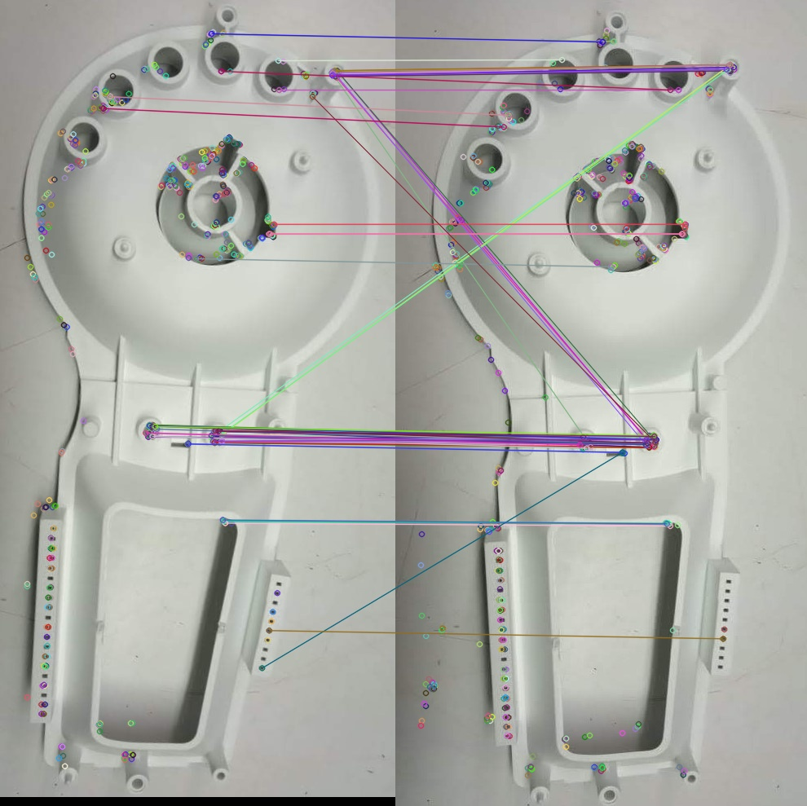
Use SIFT to extract key points
Use Constraint to limit the interaction of
Key points at different region
(i) Facial Component
(ii) Configuration Component
ORB(Oriented FAST and Rotated BRIEF)

Slide 13

$C\left(I_{P},I_{g}\right)=\frac{1}{k}\sum_{o_{1=1}}^{k}{\left(\max\left(\frac{\left\langle fpⅈ,fgⅈ\right\rangle }{\left\|f_{Pi}\right\|⋅\left\|f_{gi}\right\|}\right)\right)}$
$ⅆ_{e}=\frac{1}{n_{e}}\sum_{i=1}^{ne}{\left|ⅆ_{p_{i}}−d_{gi}\right|}$
$ⅆ_{n}=\frac{1}{n_{n}}\sum_{i=1}^{n_{n}}{\left|n_{pi}−n_{9i}\right|}$

